Slide 1
AMSC 5730
Brief introduction to semiconducting materials
Junyi Zhu

Slide 2
What are semiconductors?
Resistivity lying between 10⁻²-10⁹ Ωcm and can be modified by impurities or defects.
Energy gap lying between 0~4 eV
Insulators at 0K. Conductivity↑with T at low T
Doping decides what kind of carriers for conduction. N-type: electrons at CB or P-type: holes at VB
Notes:
2

Slide 3
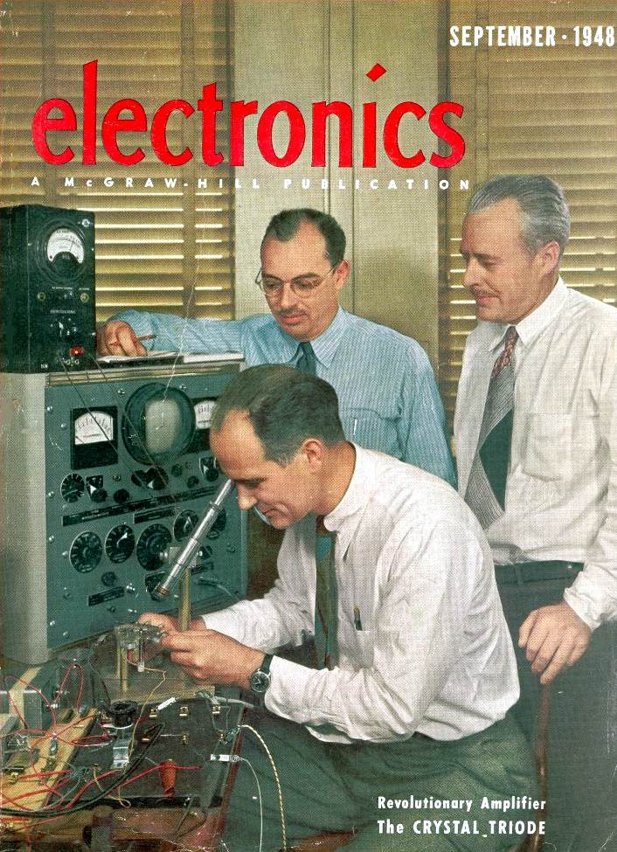
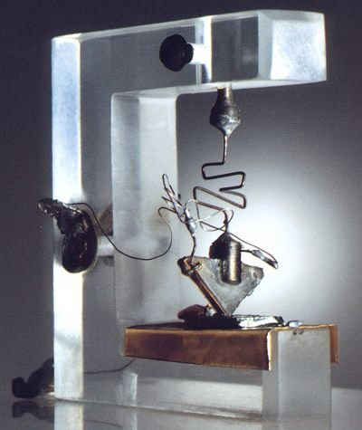
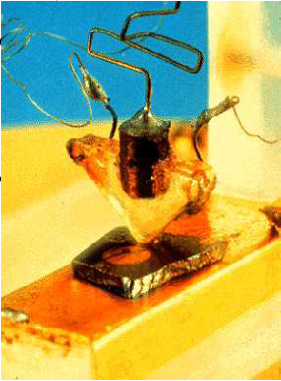
Inventors of the transistor: William Shockley (seated), John Bardeen (left) and Walter H. Brattein (right) in 1948.
They received the Nobel Prize in Physics in 1956.
The first point-contact transistor invented in 1947.
Notes:
"A picture of the first transistor ever assembled, invented in Bell Labs in 1947. It was called a point contact transistor because amplification or transistor action occurred when two pointed metal contacts were pressed onto the surface of the semiconductor material. The contacts, which are supported by a wedge shaped piece of insulating material, are placed extremely close together so that they are separated by only a few thousandths of an inch. The contacts are made of gold and the semiconductor is germanium. The semiconductor rests on a metal base.

Slide 4
Classification of Semiconductors
Elemental：Si,Ge
Compound
Binary: GaAs, GaN, ZnSe, GaSe..
Ternery: AgGaS₂, CuInSe₂..
Quarternary: Cu₂InGaS₄, Cu₂ZnSnS₄…
Other important semiconductors:
Oxides: Cu₂O, CuO, La₂CuO₄..
Magnetic: EuO, MnTe..
Ferroelectric: SbSI..
Organic: (CH)_{n}..
Notes:
4

Slide 5
According to band gap:
Direct：GaAs,InAs
Indirect：Ge,Si,AlAs
Narrow：HgTe, GaAs,
Wide：GaN
Notes:
5

Slide 6
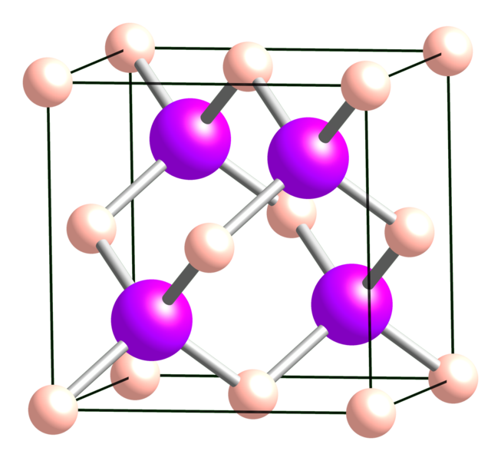
Diamond Structure
Group IV elements such as Si and Ge
Two interpenetrating fcc structures displaced with respect to each other along (111) direction by one quarter the body diagonal of the elemental cube
The basis two atoms locate at
(0,0,0) and (1/4,1/4,1/4,)a
The hard sphere filling factor is only 0.34
Simple fcc is 0.74.
How many first nearest neighbors
?

Slide 8
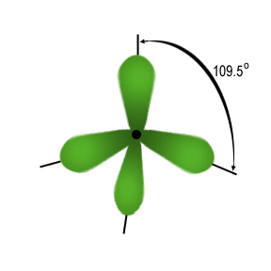
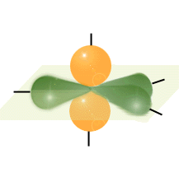

Slide 9
Optical properties near the band edge
Absorption:
Direct band gap：
Indirect：
Some common attributes:
Light element materials tend to have X valley as CBM；
Heavy ones tend to be direct band gap.
Notes:
9

Slide 10
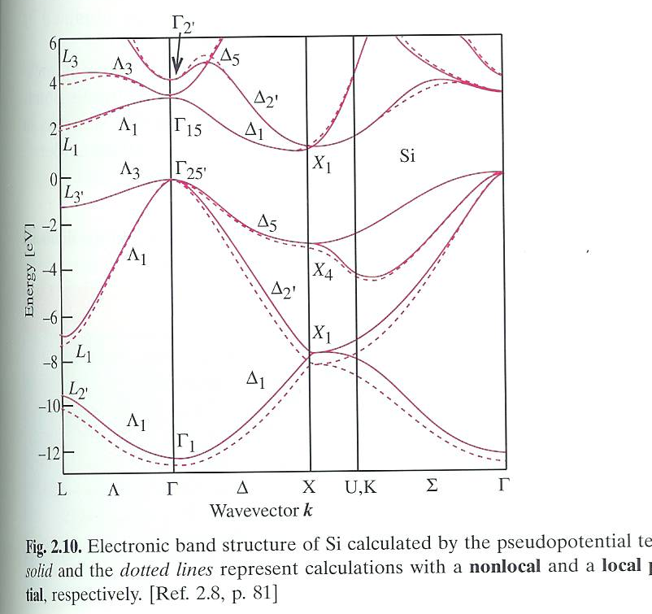
Indirect Energy-gap Bands
Si
Notes:
10

Slide 11
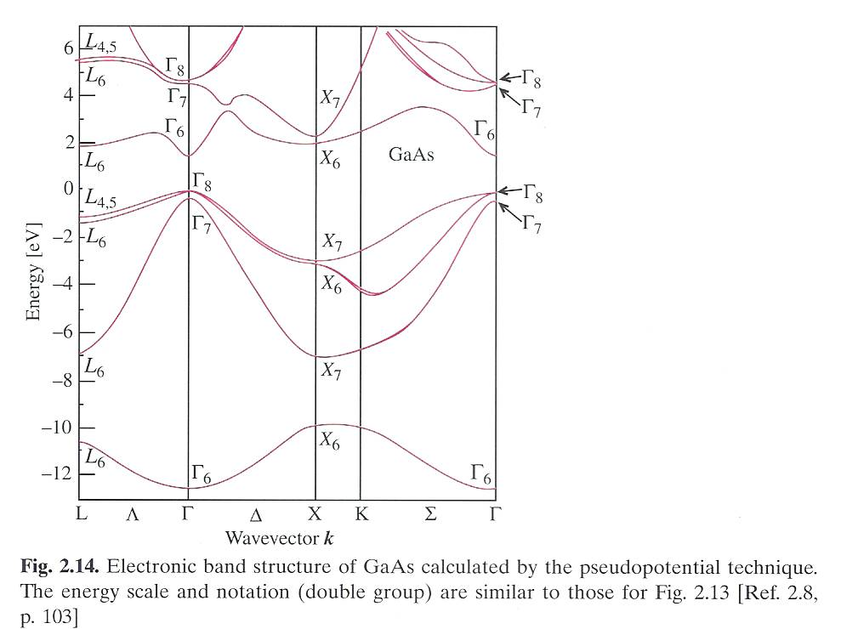
Direct Energy-gap Bands
GaAs
Notes:
11

Slide 12
Table for some semiconductors
Crystal | Type | Energy Gap (eV) | Crystal | Type | Energy Gap (eV)
Diamond | i | 5.4 | PbS | d | 0.286
Si | i | 1.17 | PbSe | d | 0.165
Ge | i | 0.744 | PbTe | d | 0.19
InSb | d | 0.24 | CdS | d | 2.582
InAs | d | 0.43 | CdSe | d | 1.84
InP | d | 1.42 | CdTe | d | 1.607
GaP | i | 2.32 | ZnO | d | 3.436
GaAs | d | 1.52 | SnTe | d | 0.3
GaSb | d | 0.81 | Cu2O | d | 2.172
AlSb | i | 1.65 | TiO | d | 3.03

Slide 13
How are semiconductors grown?
Bulk crystals
  From melt: Czochralski, Bridgman,
  From solution
  From vapor phase
Thin films (epitaxy)
  Gas Phase (Evaporation, Chemical Vapor Deposition)
  Molecular beams
  Liquid phase
Nanocrystals
  Precipitates from Solution, glass melts etc
Notes:
13

Slide 14
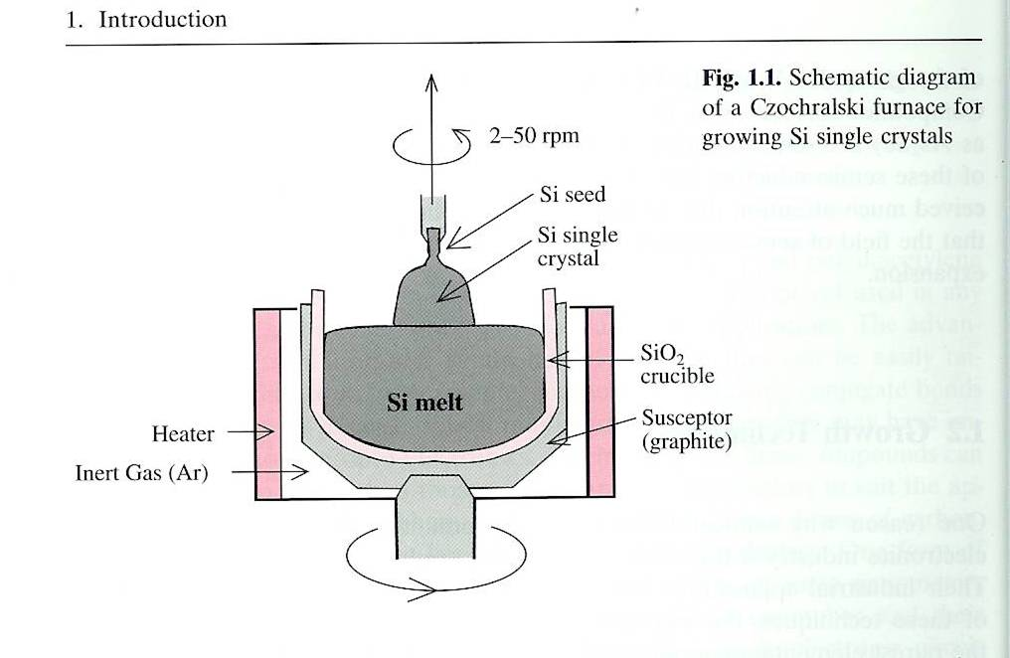
Czochralski Method
Why rotation is needed?
Notes:
14

Slide 15
Three Modes of Epitaxial Growth
2D growth: epilayer likes to adhere to substrate more than to each other
3D or island growth (Volmer-Weber mode): epilayer does not like to adhere to substrate
2D growth followed by 3D growth (Stranski-Krastanow mode): epilayer first wets substrate to form a thin layer but then balls up as the layer thickens
Notes:
15

Slide 16
How are Low-Dimensinal semiconductors grown?
Thin films (epitaxy)
  Gas Phase (Evaporation, Chemical Vapor Deposition)
  Molecular beams
  Liquid phase
Nanocrystals
  Precipitates from Solution, glass melts etc
Notes:
16

Slide 17
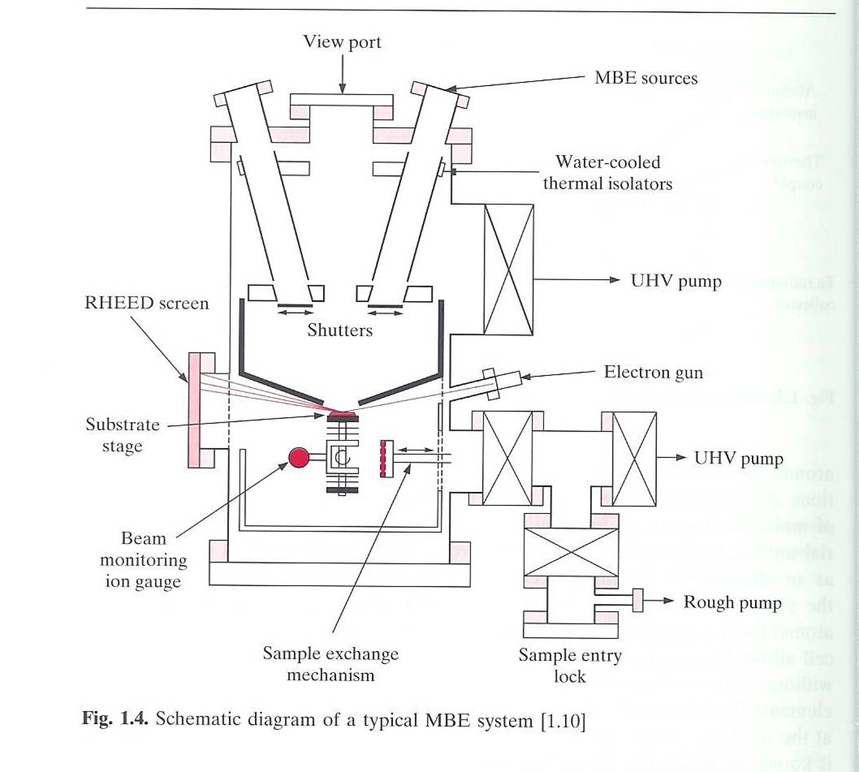
Molecular Beam Epitaxy (MBE) Machine
Notes:
17

Slide 18
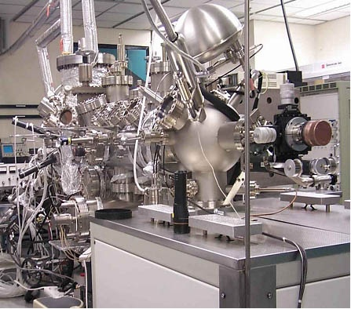
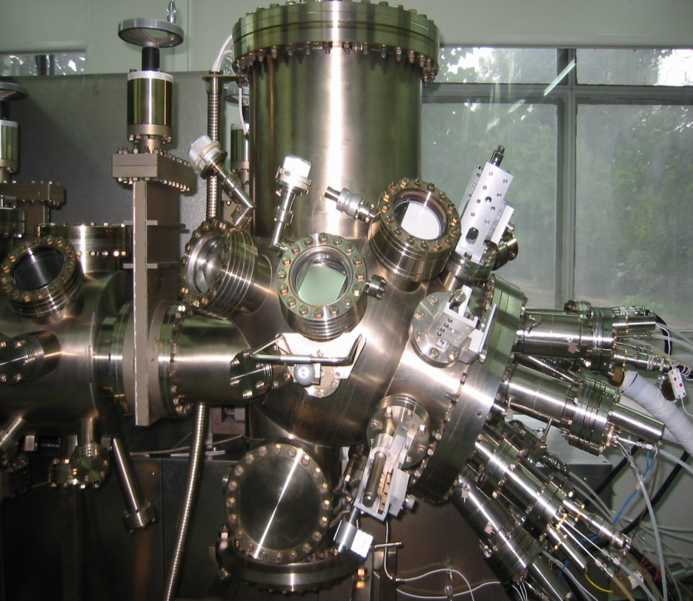
III-V MBE
II-VI MBE
Notes:
18

Slide 19
MBE Growth
Advantages:
  Ultra-high vacuum and ultra-clean
  Precision at sub-monolayer level (how?)
Disadvantages:
  Expensive machine
  Slow (rate at ~ few monolayers/min)
  Easily contaminated
  Not feasible for many compounds
Notes:
19

Slide 20
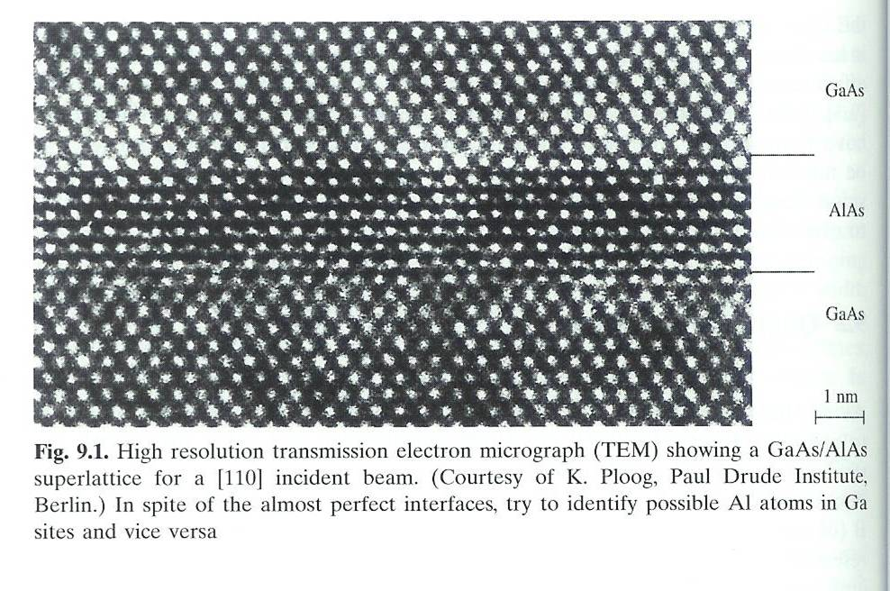
Examples of Nanostructured Semiconductors
Quantum Wells
  2D structures
  confinement of electrons in 1-Dimension only
  Example: GaAs well with GaAlAs barriers
Notes:
20

Slide 21
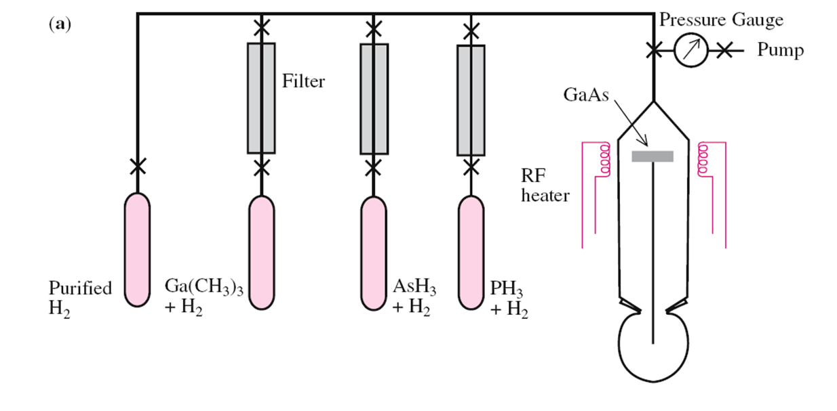

Organometallic Vapor Phase Epitaxy
(OMVPE)
Trimethylgallium
Notes:
21

Slide 22
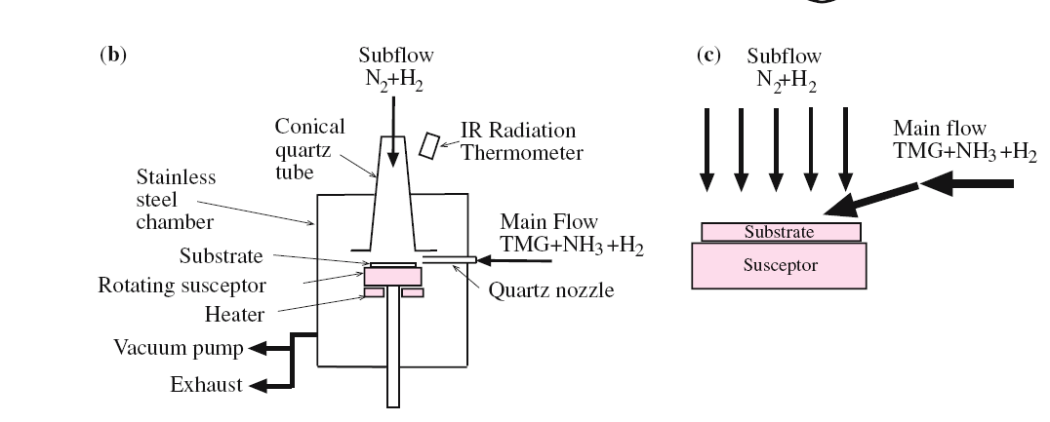

Two-flow OMVPE by Nakamura et al for growing GaN
Shuji Nakamura(中村修二)
“for the invention of efficient blue light-emitting diodes which has enabled bright and energy-saving white light sources”

Slide 23
OMVPE
Advantages:
  Fast and can be scaled up for commercial production
  Can work at relative high pressure
  Capable of almost monolayer precision
Disadvantages:
  Requires starting chemicals (precursors) to be in gas form and by-products also to be in gas form in order to be removed
  Many precursors are highly toxic and/or explosive metal-organic compounds
  Common contaminants: C, H
Notes:
23

Slide 24
Phase equilibrium
To grow semiconductors, it is essential to understand mixed phases.
A starting point is the regular solution model (I assume most of you have already learned it)
  Entropy of mixing is the ideal configurational entropy of mixing
    ΔS^{M} = -R [xln x + (1-x) ln (1-x)], x is the concentration.
  The enthalpy of mixing is done by summing nearest neighbor bond energy
    ΔH^{M} = x(1-x)Ω
    Ω is an interaction parameter.
Entropy is mixing is always negative.
However, enthalpy of mixing can be positive or negative.
  Determined by Ω.
Notes:
24

Slide 25
    Bonding energy can be approximately proportional to a^{-2.5}
      Here, a is the bond length.
    Delta lattice parameter model to estimate Ω for III-V and II-VI semiconductors
      Always positive and proportional to (a_{A}-a_{B})²/(a_{A}+a_{B})^{4.5}
      For details, refer to Organometallic vapor-phase epitaxy, G. B. Stringfellow.

Slide 26
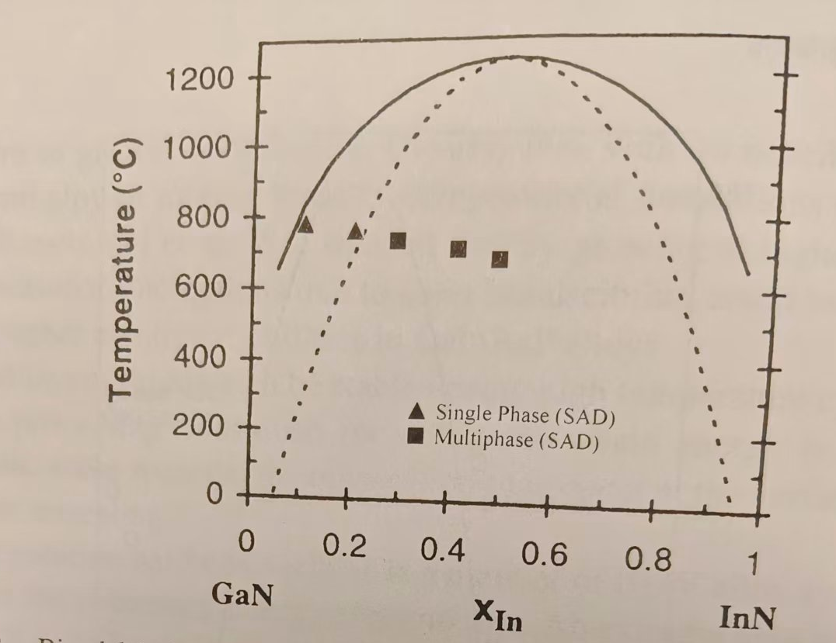
Phase Separation of InGaN
A very large positive enthalpy of mixing can overwhelm the negative entropy of mixing below critical temperature
  InGaN is metastable!
    Large size mismatch between In and Ga.
  Binodal and spinodal lines of InGaN
    Ho and Stringfellow, Appl. Phys. let. 69 270.
To understand the growth of semiconuctors, it is extremely important to construct and understand phase diagrams.
There are new approaches to calculate it
  Good review topic
Notes:
26

Slide 27
Why Study Defects?
Defects are like spice. If you put too much defects in a crystal they spoil the crystal.
  If you put too little defects in a crystal then the crystal is not too interesting nor too useful.
  A good crystal grower is a person who can introduce such the right kind and amount of defects into the sample.

Slide 28
PROS & CONS OF DEFECTS
CONS:
  Defects scatter electrons AND produce undesirable resistance
  Defects act as non-radiative recombination centers for e and h pairs and hence lower efficiencies of solar cells, photocatalyst, laser and LED etc
  Recombination at defects produce heat which prevents high power operation and can shorten the lifetime of devices.

Slide 29
PROS:
Defects can introduce free carriers and makes it possible to make pn—junctions.
Defects therefore are “enablers” of diodes, transitors, LED and lasers etc
Defects can annihilate unwanted carriers via compensation and therefore control the resistance of semiconductors all the way from metallic to insulating.
Defects can break selection rules so that transitions that are forbidden can become allowed.

Slide 30
INTRODUCTION. Classification of
Defects, their structures and symmetries
Point Defects: Intrinsic Defects & Impurities
Extended Defects: Complexes, line defects and surfaces
Shallow & Deep Impurity Levels

Slide 31
POINT DEFECTS: Intrinsic
Defects & Impurities
The simplest kind of defect is clearly one which occurs at only one lattice site.
Such defects are known as point defects and are often approximated by a point.

Slide 32
Example: Replacing a Si atom in a Si crystal by a B atom or P atom.
In both cases the foreign atom represent an impurity in an otherwise pure crystal.
We will see later that these impurity atoms behave differently in Si in terms of their electrical properties in Si (B is said to be an acceptor while P is said to be a donor).
Impurities can be detected chemically.

Slide 33
If we remove a Si atom and create a vacancy, this vacancy represents a form of defect which cannot be detected chemically.
Similarly a Si atom sitting at a site where there should not be an atom (called Interstitials) is also a kind of defect which cannot be detected chemically.
These are examples of intrinsic defects.
Intrinsic defects occur only in Materials Science.
There are no intrinsic defects in chemicals.
One questions, for intrinsic defects like Si vacancy or Si interstitial, are they donors or electrons?

Slide 34
In chemistry we represent elements by symbols.
Similarly in materials science there are special symbols for point defects which are the “elements” in materials science.
● For impurities, B_{Si}=B replacing Si
● For intrinsic defects: V_{Si}=vacancy at Si atom
● I_{Si}=Interstitial Si atom, this convention sometimes can be confusing because we may use I to dopant some compound that contains Si. Therefore, it is also common to use Si_{i} to represent it.
● In GaAs when As replaces Ga (AsGa) one obtains an Antisite defect.

Slide 35
EXTENDED DEFECTS: Complexes, line defects and surfaces
Elements can attract each other to form molecules, similarly point defects can attract each other to form complexes.
An example is the divacancy in Si. V_{Si} is a point defect. It contains 4 broken bonds and so is a very high energy state when neutral.

Slide 36
Healing of broken bonds.
The four dangling bonds are “healed” by formation of 2 new bonds.
The bond distortions (Lattice Relaxation) involved cost lattice energy.
But overall energy is still lowered. Electron energies~eV but lattice energy (~phonon energy) ~100meV. So it is a good deal!
On semiconductor surfaces, surface defects may also induce a so-called “surface reconstructions”

Slide 37
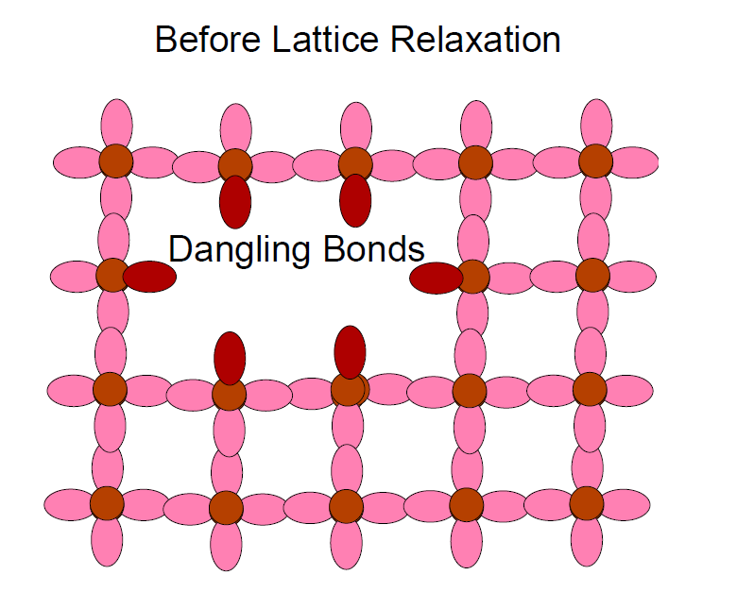
From Vacancies to Divacancy
Defects can interact like atoms to form “molecules”.
A classic example is the combination of two vacancies in Si to form a divacancy, represented as VV.
When two nearest neighbor V combine, the number of dangling bonds is reduced from 8 to 6.

Slide 38
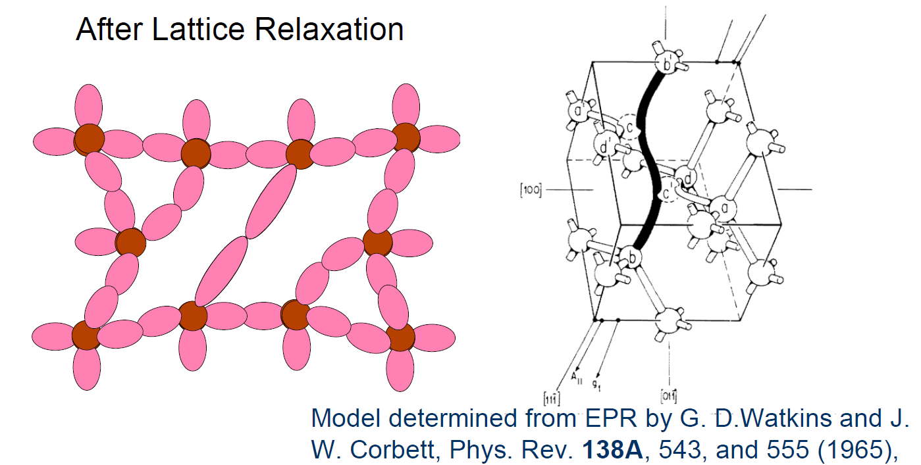

Slide 39
CLASSIFICATION OF DEFECTS BY
ELECTRONIC PROPERTIES
Donors: defects which can contribute electrons such as P_{si} in Si, Si_{Ga} in GaAs
Acceptors: defects which can accept electrons (or contribute holes) such as B_{si} in Si, Si_{As} in GaAs
Isovalent or Isoelectronic centers: N_{P} in GaP
Amphoteric: Si in GaAs since SiGa is a donor while SiAs is an acceptor.

Slide 40
What determines the defect properties?
Combination of Two factors:
  (1) “Local factor” such as chemical nature of defect
  (2) “Host factor” such as properties of the host lattice like band structure, phonon energies
Factor (1) breaks translational symmetry and requires understanding of chemistry and atomic physics
Factor (2) emphasize knowledge of Solid State Physics more than chemistry.
Donors and acceptors are examples where Factor (2) dominates and the chemical nature of the impurities is less important.

Slide 41
Defects are present in practically all solids.
Defects can take all forms and shapes varying from isolated atomic sites to macroscopic objects which extend throughout the whole solid.
The most powerful way to study defects is to understand their structure and symmetry.
Many defects are strongly affected by their local symmetry.
Lattice distortion allows defects to lower their electronic energy at the expense of small lattice energy.
Understanding the properties of defects is crucial in making useful devices.

Slide 42
ELECTRONIC PROPERTIES OF SHALLOW DEFECTS IN SEMICONUCTORS
Donors
Acceptors

Slide 43
In Physics we try to simplify a problem by making assumptions and simplifications.
The ideal assumptions will make the problem solvable analytically and can be applied to a large number of cases irrespective of the chemical nature of the defect.
One such example is the hydrogenic model.
So let us assume that we don’t need a very high accuracy and pretend that all different donors and acceptors share something in common. What is that common thing?

Slide 44
Assume an impurity like P substituting for a Si host atom
  (a donor by our scheme of classification).
Compared to Si there is an extra valence electron e in P
In a P atom, this extra e is quite strongly bounded to the P nucleus via a Coulomb attraction.
The nucleus of P is screened by inner electrons and valence electrons.
However with even all these screening, the Coulomb attraction is of the order eV or more.

Slide 45
In Si this e is very weakly bound to P+ by the Coulomb Potential because there is a huge number of valence electrons in a piece of Si and they will screen strongly the Coulomb potential.
An approximation of this screened Coulomb Potential is given by : e/ε₀r .
ε₀ is the dielectric constant of Si and it takes care of the screening of the impurity potential by the valence electrons.
Notice that Si is covalent so there is no screening by the ions. For ionic crystals, we have extra terms.

Slide 46
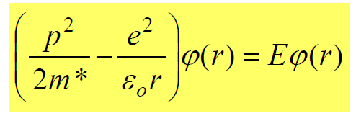
To obtain the Schrödinger Equation for the e we have to make another approximation.
Unlike the e in the hydrogen atom this e moves into a crystal.
Its mass is changed by its interaction with other electrons.
The effect of the “drag” by the other electrons and ions can be approximated by an Effective Mass m*.
In this Effective Mass Approximation the Schrödinger
This approach to calculate the electronic properties of an impurity is therefore known as the hydrogenic approximation.

Slide 47
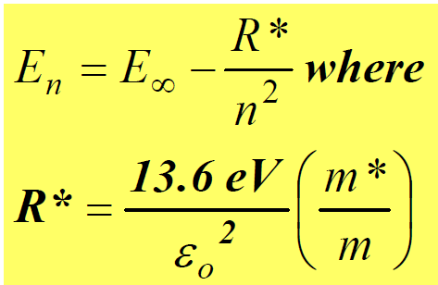
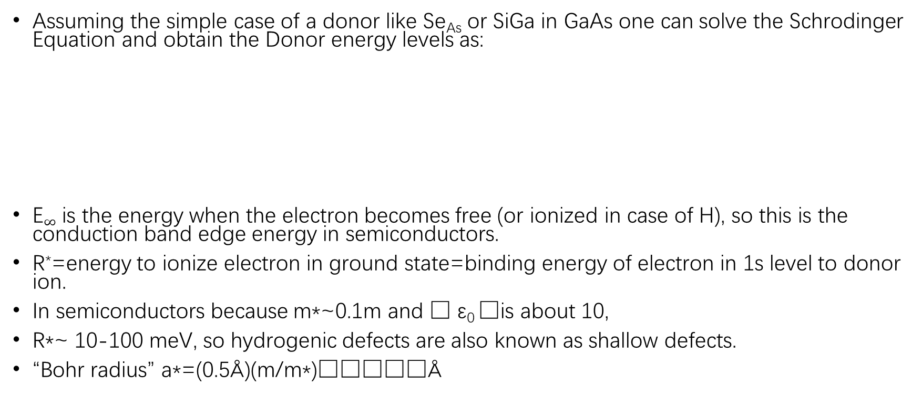
EFFECTIVE MASS APPROXIMATION & THE HYDGROGENIC DONOR
Assuming the simple case of a donor like Se_{As} or SiGa in GaAs one can solve the Schrodinger Equation and obtain the Donor energy levels as:
E$∞$ is the energy when the electron becomes free (or ionized in case of H), so this is the conduction band edge energy in semiconductors.
R*=energy to ionize electron in ground state=binding energy of electron in 1s level to donor ion.
In semiconductors because m*~0.1m and  ε₀ □is about 10,
R*~ 10-100 meV, so hydrogenic defects are also known as shallow defects.
“Bohr radius” a*=(0.5Å)(m/m*)□Å

Slide 49
p-n Junction
p-n junctions are of great importance both in modern electronic applications and in understanding other semiconductor devices.
The p-n junction theory serves as the foundation of the physics of semiconductor devices.
The basic theory of current voltage characteristics of p-n junctions was established by Shockley.
This theory was then extended by Sah, Noyce, and Shockley, and by Moll.

Slide 50
Abrupt Junction
When the impurity concentration in a semiconductor changes abruptly from acceptor impurities N_{A} to donor impurities N_{D}, as shown in Fig. la, one obtains an abrupt junction.

Slide 51
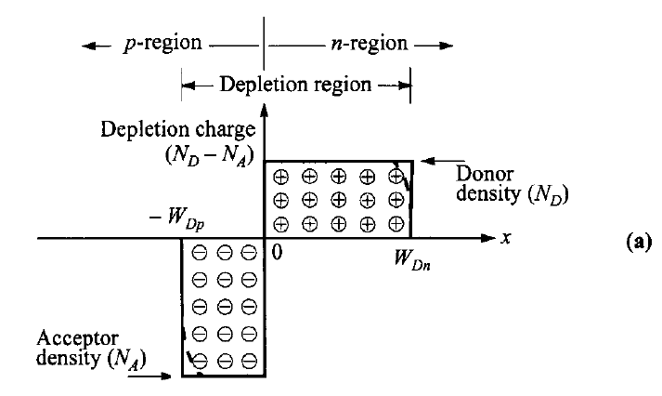

Slide 52
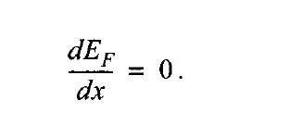
We first consider the thermal equilibrium condition, that is, one without applied voltage and current flow.

Slide 53
Thus the condition of zero net electron and hole currents requires that the Fermi level must be constant throughout the sample.
The built-in potential or diffusion potential, as shown in Fig. 1 b, c, and d, is equal to

Slide 54
For non-degenerated semiconductors,

Slide 55
CURRENT-VOLTAGE CHARACTERISTICS
Shockley equation.
The ideal current-voltage characteristics are based on the following four assumptions:
( 1 ) the abrupt depletion-layer approximation; that is, the built-in potential and applied voltages are supported by a dipole layer with abrupt boundaries, and outside the boundaries the semiconductor is assumed to be neutral;
(2) the Boltzmann approximation;
(3) the low-injection assumption; that is, the injected minority carrier densities are small compared with the majority-carrier densities;
(4) no generation-recombination current exists inside the depletion layer, and the electron and hole currents are constant throughout the depletion layer.

Slide 56
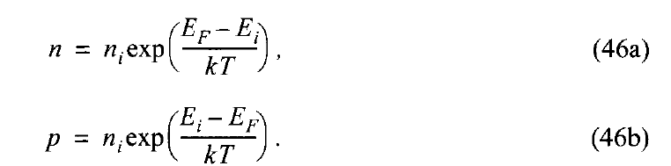
CURRENT-VOLTAGE CHARACTERISTICS
We first consider the Boltzmann relation. At thermal equilibrium this relation is given by
At thermal equilibrium, the pn product from the above equations is equal to n_{i}². Here, n_{i} is about 10¹⁰ /cm³ for Si at room temperature.
When voltage is applied, the minority-carrier densities on both sides of the junction are changed, and the pn product is no longer equal to n_{i}².

Slide 57
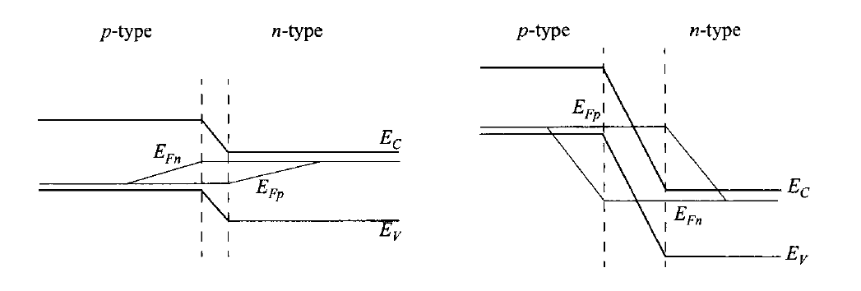
Quasi fermi level

Slide 58
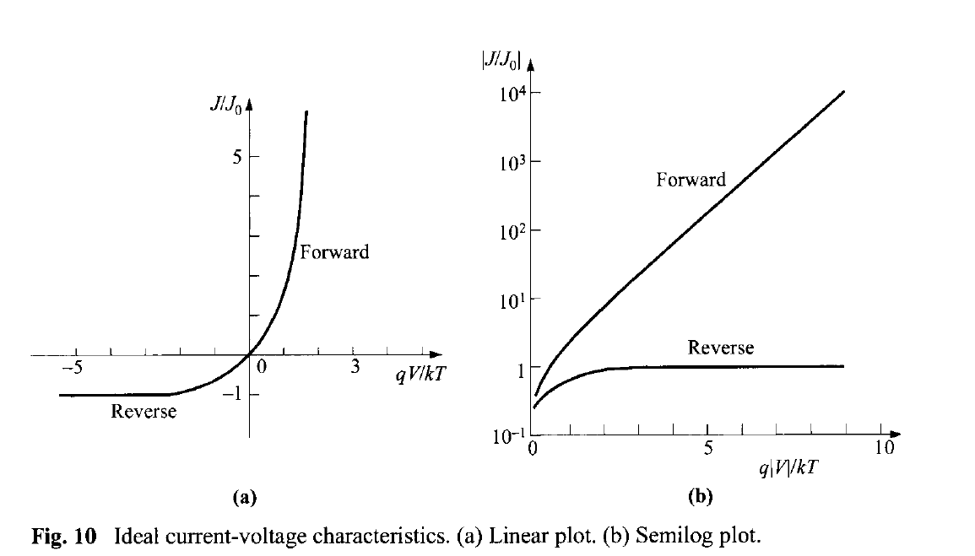

Slide 59
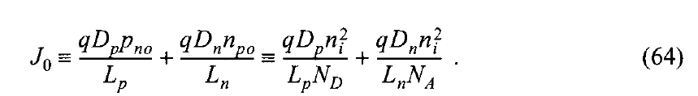
Next, you need to learn a little bit of electrodynamics to follow the whole derivation on the current density as a function of e-field.
Here, I give you the general form of the total current, Shockley equation! Ideal diode law.

Slide 60
Suggested final presentation topics
1. review of Semiconductor alloys and their applications
2. Doping and defects in semiconductor materials
3. Physical origin of band gap and carrier mobility
4. pn junction and light emitting diodes
5. brief review of epitaxial growth
6. Alloys and phase diagram of semiconductor alloys

Slide 61
Suggested final essay topics
1. How to control doping and defects in wide band gap semiconductors
2. Review of OMVPE technique in nitride and phosphide.
3. Modern technique to construct phase diagram of semiconductor alloys
4. brief review of transport calculations based on carrier concentrations and mobility
5. Wetting conditions in epitaxial growth of semiconductors
6. Brief historical review of light emitting diodes

